Slide 1
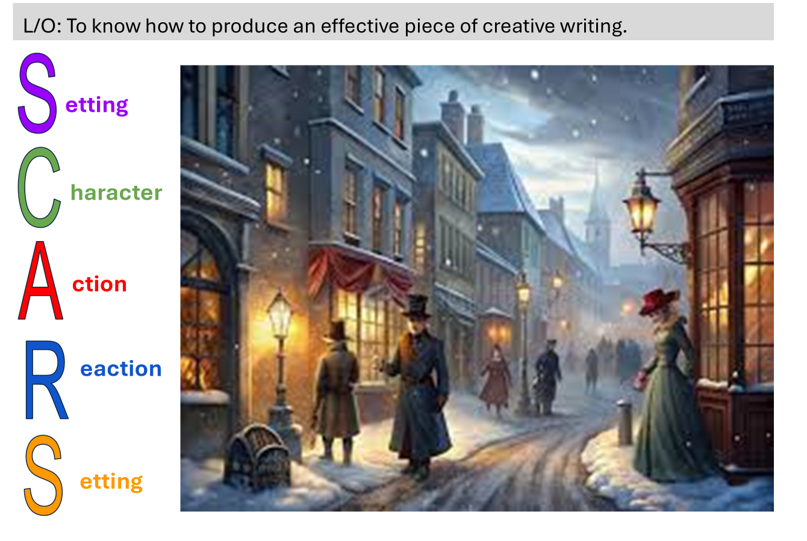
KS4 English: Descriptive Writing Independent Study
Objective
• To recap descriptive writing techniques.
• To know how to produce a convincing and compelling piece of creative writing

Slide 2
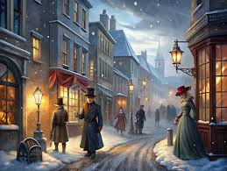
Task 1: Recap of Descriptive Techniques
Good descriptive writing uses sensory details and literary techniques to create vivid images. Below is an extract from ‘A Christmas Carol’.
"It was cold, bleak, biting weather: foggy withal: and he could hear the people in the court outside go wheezing up and down, beating their hands upon their breasts, and stamping their feet upon the pavement-stones to warm them. The city clocks had only just gone three, but it was quite dark already: it had not been light all day; and candles were flaring in the windows of the neighbouring offices, like ruddy smears upon the palpable brown air. The fog came pouring in at every chink and keyhole, and was so dense without, that the houses opposite were mere phantoms.".
Can you find and highlight the following?
Sensory imagery (sight, sound, touch, taste, smell)
Personification
Adjectives and adverbs
Metaphors / similes

Slide 3
Task 1: Recap of Descriptive Techniques
Good descriptive writing uses sensory details and literary techniques to create vivid images. Below is an extract from ‘A Christmas Carol’.
"It was cold, bleak, biting weather: foggy withal: and he could hear the people in the court outside go wheezing up and down, beating their hands upon their breasts, and stamping their feet upon the pavement-stones to warm them. The city clocks had only just gone three, but it was quite dark already: it had not been light all day; and candles were flaring in the windows of the neighbouring offices, like ruddy smears upon the palpable brown air. The fog came pouring in at every chink and keyhole, and was so dense without, that the houses opposite were mere phantoms."
Can you find and highlight the following?
Sensory imagery (sight, sound, touch, taste, smell)
Personification
Adjectives
Metaphors / similes

Slide 4

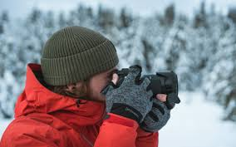
Task 2: You should now produce your own piece of descriptive writing.
S
etting
You can use this image of a bustling Victorian street at night, illuminated by gas lamps, with snow covering the ground.
OR
Go outside, explore and take a photograph of a scene you would like to describe.
C
haracter
A
ction
R
eaction
S
Take 5 minutes to plan your writing.
Use the SCARS structure and the language techniques you have revised.
Use the notes and ideas on the next slide to help you.
etting
Notes:
Students plan again, using this structure.

Slide 5
L/O: To know how to produce an effective piece of creative writing: Here is the structure to follow and some ideas.
P1: Setting
Begin by describing the location. Use sensory details and set the tone using the weather.
Example Starter:
“The street was alive with muffled voices and the rhythmic clatter of hooves against cobblestones. Gas lamps cast a warm, flickering glow through the swirling fog, their light barely piercing the winter gloom.”
P2: Character (person/animal/object)
Zoom in on a character in the setting. Describe their appearance, emotions, or actions.
Example Starter:
"A young boy in a threadbare coat darted between the carriages, his breath puffing like tiny clouds in the frigid air. His fingers, raw and red, clutched a bundle of newspapers."
P3: Action.
Describe an action involving the character and/or setting to create movement or tension.
Example Starter:
"He paused for a moment, his eyes scanning the crowd, before calling out, 'Extra! Extra!' His voice cut through the air, desperate to be heard over the city’s din."
P5: Setting.
Conclude by returning to the setting to show how it changes or stays the same.
Example Starter:
"The boy disappeared into the crowd, leaving the street to the endless fog, the flickering lamps, and the restless hum of the city."
P4: Reaction. Show how the character or setting reacts to the action. You could use a flashback.
Example Starter:
"A man in a heavy coat stopped, fishing a coin from his pocket. The boy’s eyes lit up, and he rushed forward, almost slipping on the icy pavement."
Challenge-Can you write metaphorically about the image? Describe it as if an artist is painting it.
Notes:
Show students what I got. Can add to their plan if they have any missing areas or if they are REALLY stuck.

Slide 6

L/O: To know how to produce an effective piece of creative writing.
Can you find and highlight the following in your own writing?
Sensory imagery
Personification
Adjectives
Metaphors / similes
Self Assessment
WWW - what methods have you used in your writing?
EBI - which areas of this task do you feel you need extra support with?

