Slide 1
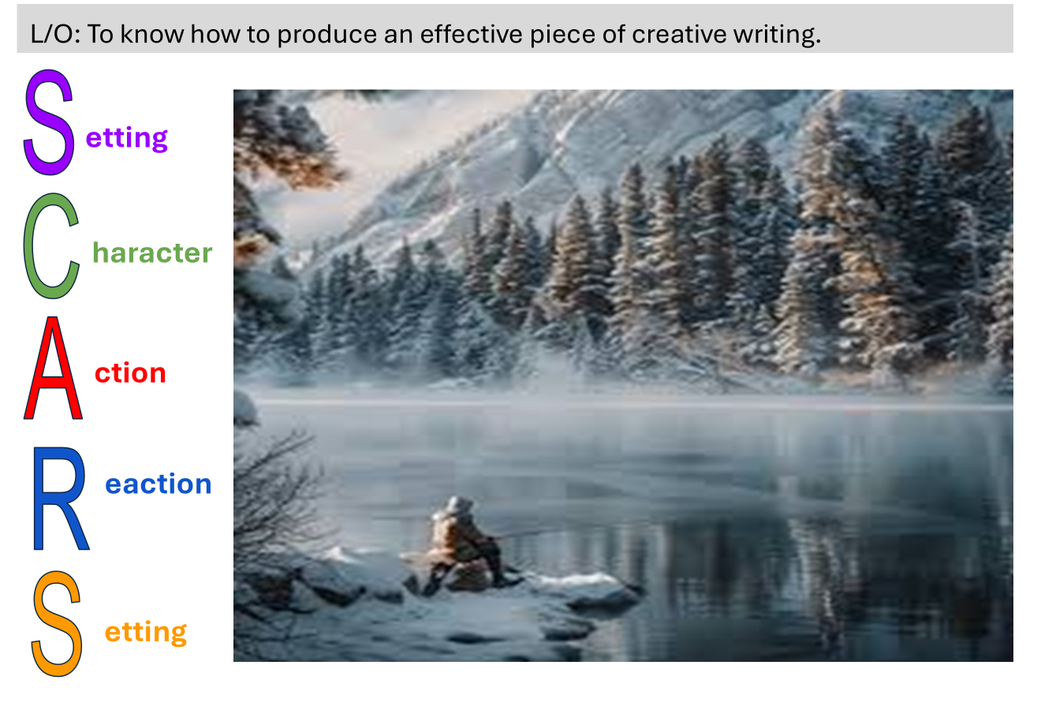
KS3 English: Descriptive Writing Independent Study
You
Objective
• To recap descriptive writing techniques.
• To know how to produce a convincing and compelling piece of creative writing

Slide 2
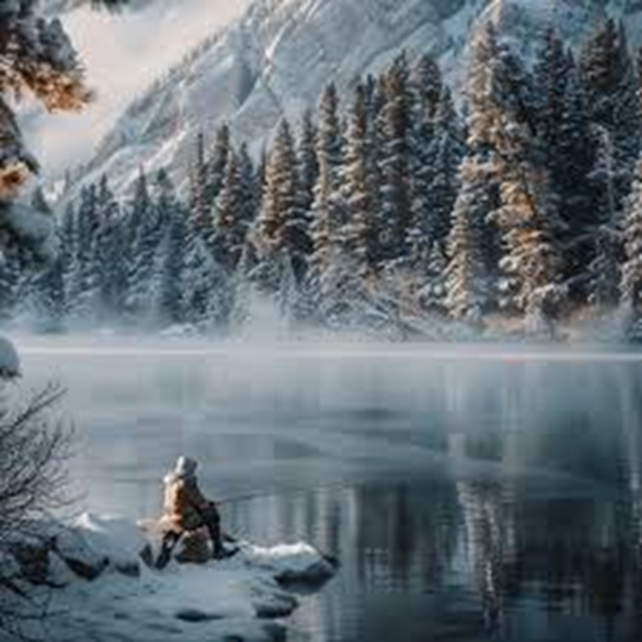
Task 1: Recap of Descriptive Techniques Good descriptive writing uses sensory details and literary techniques to create vivid images. Below is an extract.
The forest stood in a quiet stillness, except for the occasional rustle of leaves stirred by the soft wind. Shafts of golden light pierced through the canopy, illuminating the thick carpet of moss below. A small deer nervously, crept out from the shadows, its hooves sinking softly into the ground. Suddenly, a twig snapped. The deer froze, its eyes wide with fear, before bounding back into the dense undergrowth. The forest sighed, returning to its timeless watch.
Can you find and highlight the following?
Sensory imagery (sight, sound, touch, taste, smell)
Personification
Adjectives and adverbs
Metaphors / similes

Slide 3
Task 1: Recap of Descriptive Techniques Good descriptive writing uses sensory details and literary techniques to create vivid images. Below is an extract.
The forest stood in a quiet stillness, except for the occasional rustle of leaves stirred by the soft wind. Shafts of golden light pierced through the canopy, illuminating the thick carpet of moss below. A small deer nervously, crept out from the shadows, its hooves sinking softly into the ground. Suddenly, a twig snapped. The deer froze, its eyes wide with fear, before bounding back into the dense undergrowth. The forest sighed, returning to its timeless watch.
Can you find and highlight the following?
Sensory imagery (sight, sound, touch, taste, smell)
Personification
Adjectives and adverbs
Metaphors / similes

Slide 4
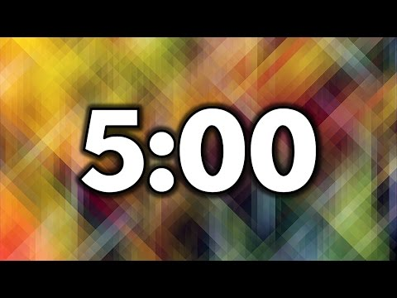
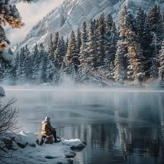
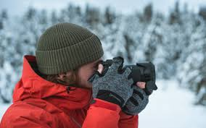
Task 2: You should now produce your own piece of descriptive writing.
S
You can use this image.
OR
Go outside, explore and take a photograph of a scene you would like to describe.
etting
C
haracter
A
ction
Take 5 minutes to plan your writing.
Use the SCARS structure and the language techniques you have revised.
Use the notes and ideas on the next slide to help you.
R
eaction
S
etting
Notes:
Students plan again, using this structure.

Slide 5
L/O: To know how to produce an effective piece of creative writing: Here is the structure to follow and some ideas.
P1: Setting
Begin by describing the location. Use sensory details and set the tone using the weather.
Example Starter: "The snow stretched endlessly, a pristine blanket that sparkled in the pale light. The air was crisp and carried the faint scent of pine, while the muffled crunch of falling snow whispered in the silence.“
P2: Character (person/animal/object)
Zoom in on a character in the setting. Describe their appearance, emotions, or actions.
Example Starter: "A lone figure stood at the edge of the frozen lake; their red coat vivid against the icy backdrop. They clutched their scarf tightly, the frosty breath escaping their lips in white puffs."
P3: Action.
Describe an action involving the character and/or setting to create movement or tension.
Example Starter: "They took a tentative step onto the ice, the surface creaking softly beneath their weight. A snowflake landed on their cheek, melting almost instantly against their warmth."
P5: Setting.
Conclude by returning to the setting to show how it changes or stays the same.
Example Starter: "The snowfall thickened, cloaking the world in white. The figure disappeared into the swirling flakes, leaving only faint footprints behind."
P4: Reaction. Show how the character or setting reacts to the action. You could use a flashback.
Example Starter: "A gust of wind swirled the snow around them, making them stumble. The trees seemed to shudder in unison, as though watching their every move."
Challenge-Can you write metaphorically about the image? Describe it as a scene from a school/playground/an artist painting
Notes:
Show students what I got. Can add to their plan if they have any missing areas or if they are REALLY stuck.

Slide 6

L/O: To know how to produce an effective piece of creative writing.
Can you find and highlight the following in your own writing?
Sensory imagery
Personification
Adjectives and adverbs
Metaphors / similes
Self Assessment
WWW - what methods have you used in your writing?
EBI - which areas of this task do you feel you need extra support with?

